Slide 1


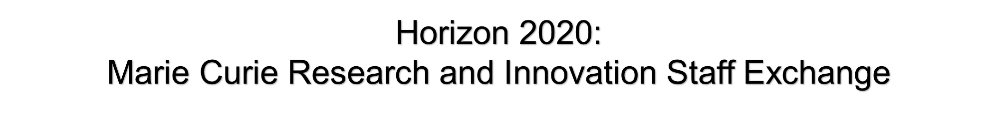
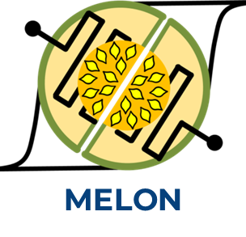


Slide 2
Activities:
Worked synthesis and characterization of two-dimensional (2D) materials aimed at nanoelectronics applications.
Developed several synthesis and transfer techniques for graphene and graphene-derived nanomaterials.
Worked on the advanced characterization of these nanomaterials using high-resolution transmission electron microscopy (HRTEM), scanning transmission electron microscopy (STEM), energy-dispersive X-ray spectroscopy (EDS), and electron energy-loss spectroscopy (EELS).
Notes:
Conducted synthesis and characterization of two-dimensional (2D) materials aimed at nanoelectronics applications.
Developed several synthesis and transfer techniques specifically tailored for graphene and graphene-derived nanomaterials.
Worked on the advanced characterization of these nanomaterials using high-resolution transmission electron microscopy (HRTEM), scanning transmission electron microscopy (STEM), energy-dispersive X-ray spectroscopy (EDS), and electron energy-loss spectroscopy (EELS).

Slide 3
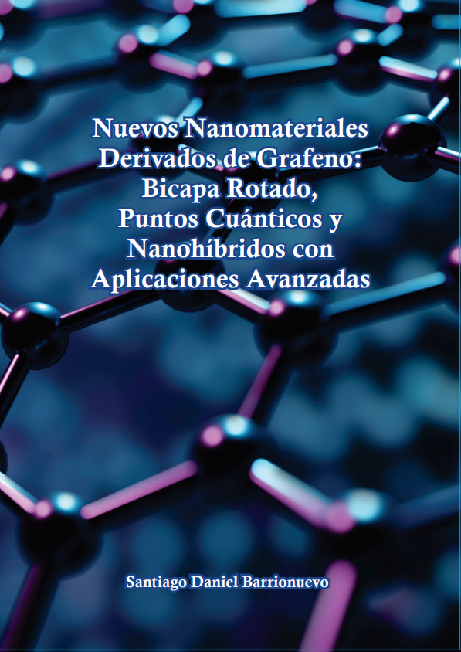
Published Thesis
Published Work (4)
Barrionuevo, S. D.; Fioravanti, F.; Nuñez, J. M.; Muñeton Arboleda, D.; Lacconi, G. I.; Bellino, M. G.; Aguirre, M. H.; Ibañez, F. J. Stacking-Configuration-Preserved Graphene Quantum Dots Electrochemically Obtained from CVD Graphene. J. Phys. Chem. C 2024, 128 (3), 1393–1403. https://doi.org/10.1021/acs.jpcc.3c06871.
Barrionuevo, S. D.; Fioravanti, F.; Nuñez, J. M.; Llaver, M.; Aguirre, M. H.; Bellino, M. G.; Lacconi, G. I.; Ibañez, F. J. Efficient Generation of Highly Crystalline Carbon Quantum Dots via Electrooxidation of Ethanol for Rapid Photodegradation of Organic Dyes. J. Mater. Chem. C 2023, 11 (34), 11719–11729. https://doi.org/10.1039/D3TC01774E.
Llaver, M.; Barrionuevo, S. D.; Nuñez, J. M. M.; Chapana, A.; Wuilloud, R. G.; Aguirre, M. H.; Ibañez, F. J. Fluorescent Graphene Quantum Dots-Enhanced Machine Learning for Accurate Detection and Quantification of Hg2+ and Fe3+ in Real Water Samples. Environ. Sci.: Nano 2024. https://doi.org/10.1039/D3EN00702B.
Barrionuevo, S. D. New Nanomaterials derived from Graphene: Twisted Bilayer Graphene, Graphene Quantum Dots and Graphene-Metal Nanohybrids with Advanced Applications. Thesis PhD Engineering. SEDICI. 2024. https://doi.org/10.35537/10915/169400
Submitted/Drafted Work (3)
Barrionuevo, S. D.*; Ventre, J*.; Nuñez, J. M.; Renna, A.; Aguirre, M. H.; Bellino, M. G.; Ibañez, F. J. GQDs toward the Spontaneous Synthesis of core-shell Au-graphene Nanohybrid for Non-enzymatic Glucose Detection. ACS Applied Nanomaterials 2025 (Submitted) * Both First Authors
Barrionuevo, S. D.; Nuñez, J. M.; Ibañez, F. J. ; M. Aguirre. Size Threshold for Edge State Emergence in Graphene Quantum Dots (GQDs). 2025 Manuscript.
Barrionuevo, S. D.; Nuñez, J. M.; Ibañez, F. J. ; M. Aguirre. Synthesis and Characterization of Twisted Bilayer Graphene via Wet Transfer & HRTEM/EELS. 2025 Manuscript.
Awarded Proposals (2)
Barrionuevo, S. D.; M. Aguirre. Size Threshold for Edge State Emergence in Graphene Quantum Dots (GQDs). ELECMI 2024/2025 Awarded Proposal.
Barrionuevo, S. D.; M. Aguirre. Electronic Structure Analysis of Twisted Bilayer Graphene at Specific Rotation Angles. ELECMI 2024/2025 Awarded Proposal.

Slide 4
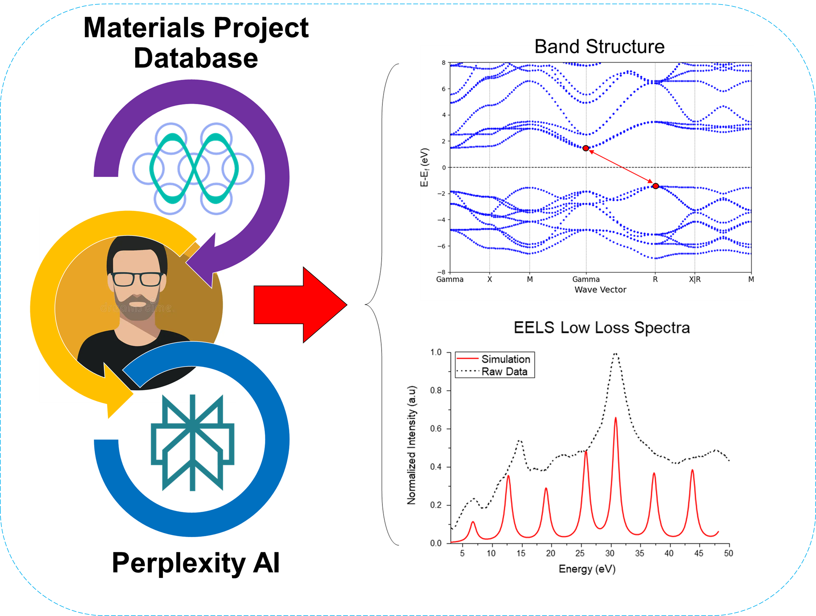
Current Work
Developing an AI assisted Neuromorphic Material Simulator
Notes:
The program serves as an integrated simulation platform that automates and streamlines first-principles materials calculations using Quantum ESPRESSO. It guides users through multiple workflows—whether they have a known Materials Project ID or are exploring new, unpublished materials—by generating tailored input files, running comprehensive electronic structure simulations (including SCF, NSCF, band structure, DOS, and EELS calculations), and finally providing AI-driven analysis of the outputs. This comprehensive approach not only reduces manual intervention and error but also offers expert parameter optimization and literature-backed recommendations. Such capabilities are critical for the MELON project, as they enable researchers to efficiently simulate and evaluate the electronic and spintronic properties of advanced materials, thereby accelerating the discovery and design of novel components essential for neuromorphic computing applications.

Slide 5
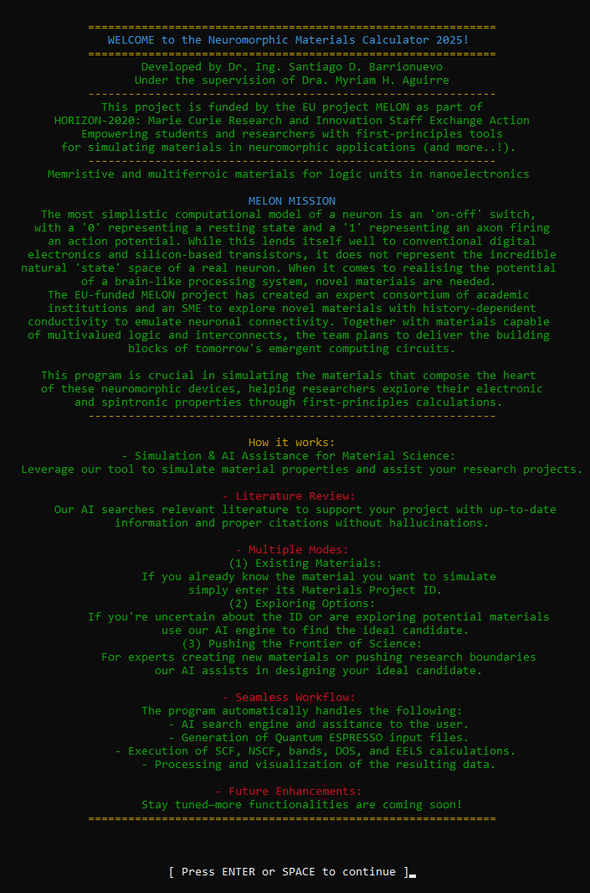
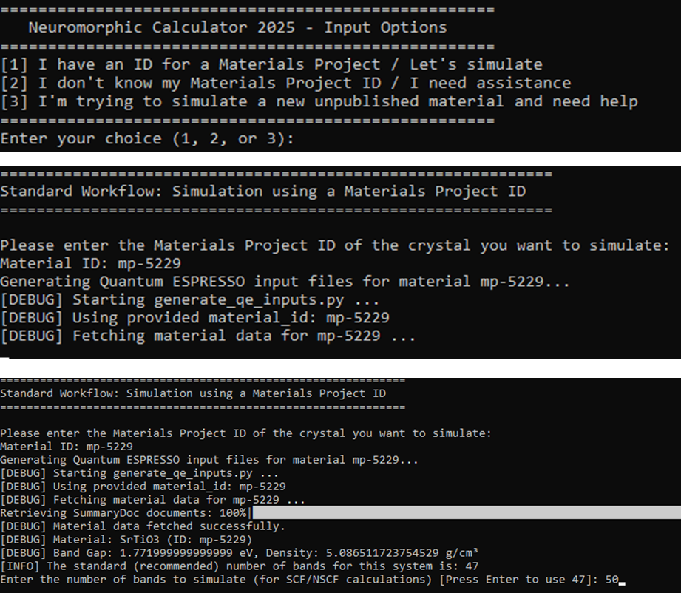
Current Work
Developing an AI assisted Neuromorphic Material Simulator
Notes:
The program serves as an integrated simulation platform that automates and streamlines first-principles materials calculations using Quantum ESPRESSO. It guides users through multiple workflows—whether they have a known Materials Project ID or are exploring new, unpublished materials—by generating tailored input files, running comprehensive electronic structure simulations (including SCF, NSCF, band structure, DOS, and EELS calculations), and finally providing AI-driven analysis of the outputs. This comprehensive approach not only reduces manual intervention and error but also offers expert parameter optimization and literature-backed recommendations. Such capabilities are critical for the MELON project, as they enable researchers to efficiently simulate and evaluate the electronic and spintronic properties of advanced materials, thereby accelerating the discovery and design of novel components essential for neuromorphic computing applications.

Slide 6
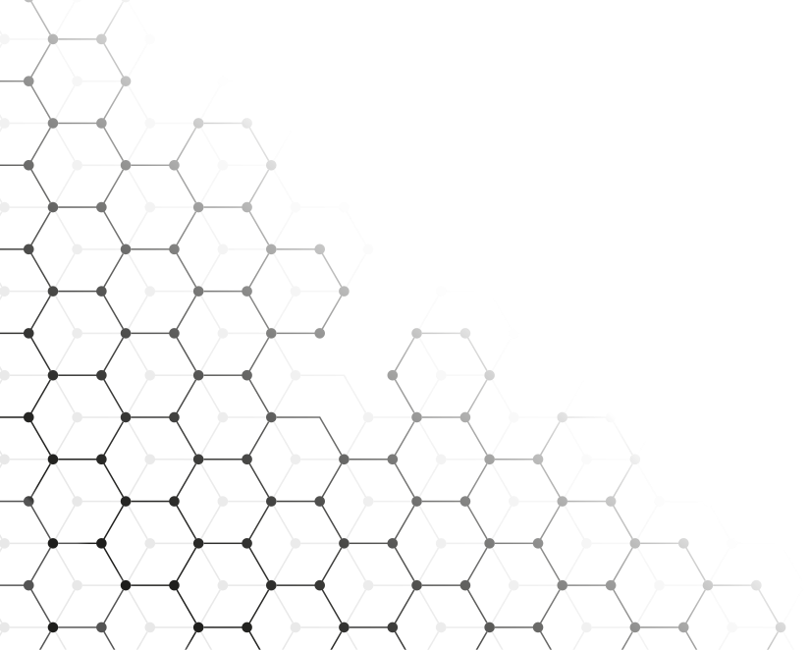
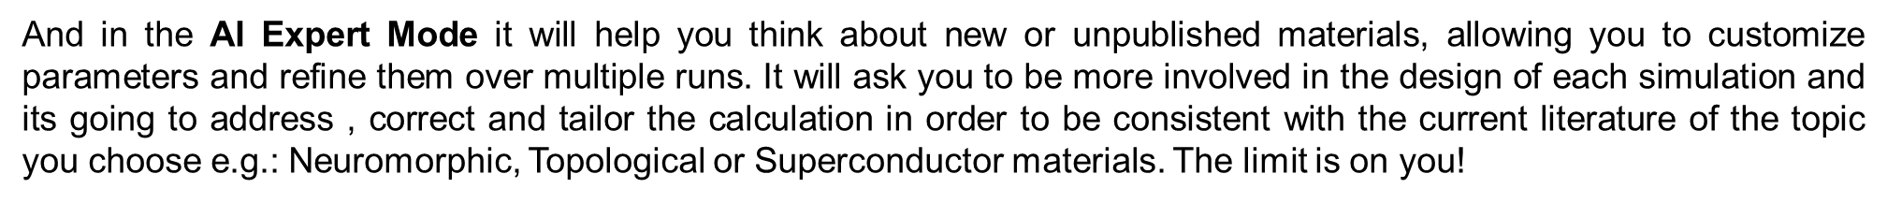
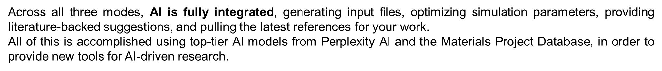
Current Work
Developing an AI assisted Neuromorphic Material Simulator

Slide 7

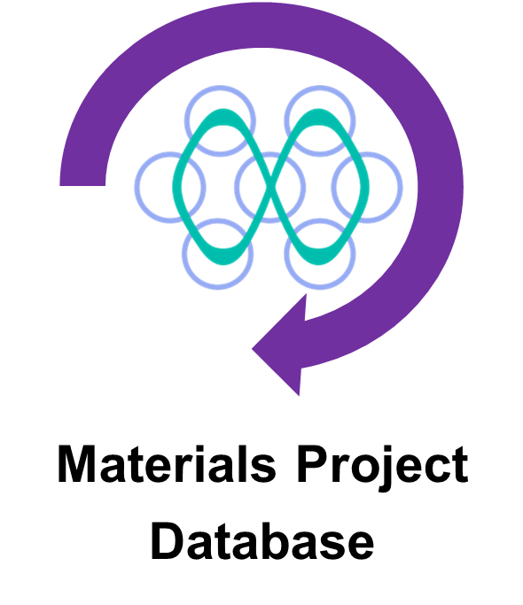
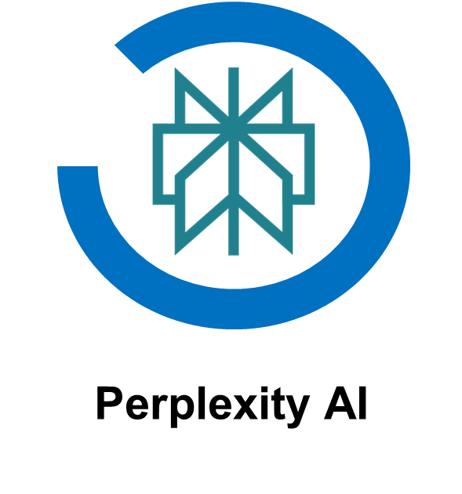
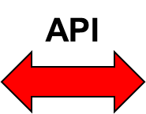
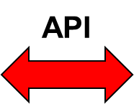
Current Work
Developing an AI assisted Neuromorphic Material Simulator
How does it work?

Slide 8
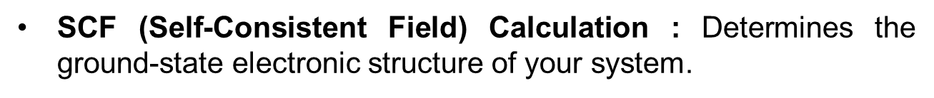
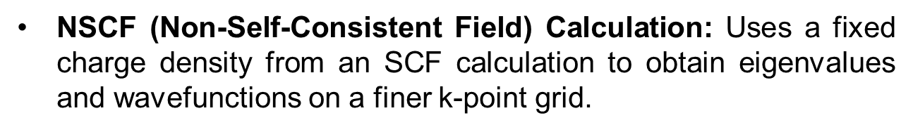
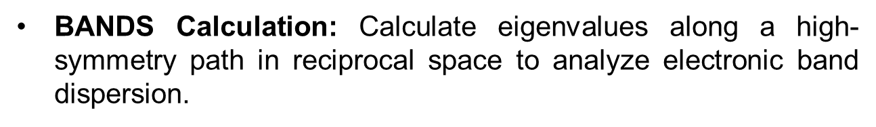
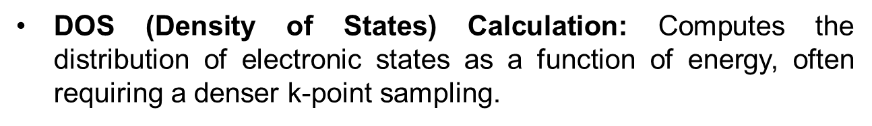
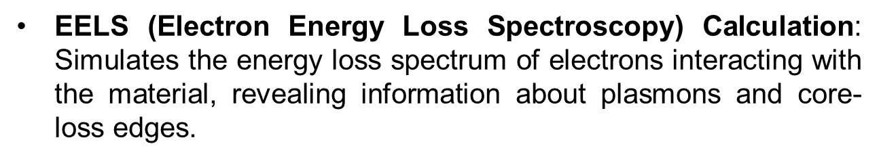
Current Work
Developing an AI assisted Neuromorphic Material Simulator
How does it work?
What can you do?

Slide 9

Current Work
Developing an AI assisted Neuromorphic Material Simulator
How does it work?
What can yo do?
Where can I find it?
SCF (Self-Consistent Field)
NSCF (Non-Self-Consistent Field)
BANDS Calculation
DOS (Density of States)
EELS (Electron Energy Loss Spectroscopy)
https://github.com/SantiagoBLP/NeuroCalc2025_1.0

Slide 10
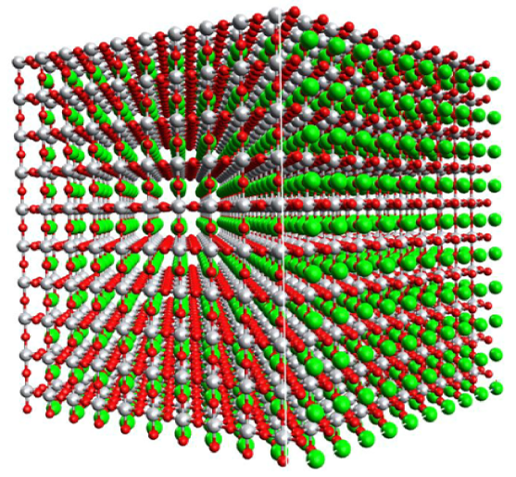
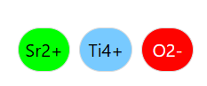
Current Work
Developing an AI assisted Neuromorphic Material Simulator:
Example Case SrTiO3 (Cubic)

Slide 11
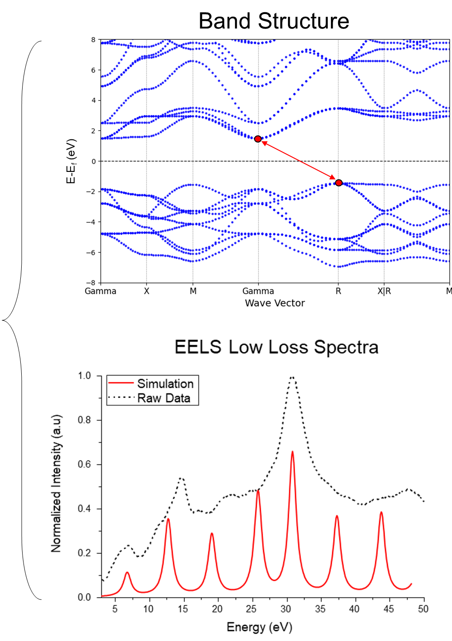
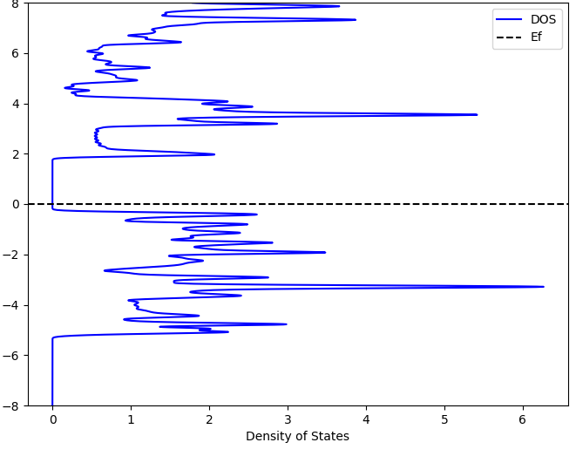
Current Work
Developing an AI assisted Neuromorphic Material Simulator:
Example Case SrTiO3 (Cubic)
Density of State (DOS)

Slide 12
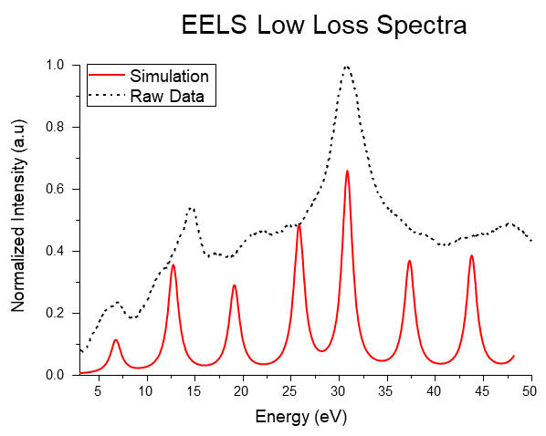
Current Work
Developing an AI assisted Neuromorphic Material Simulator:
Example Case SrTiO3 (Cubic)

Slide 13
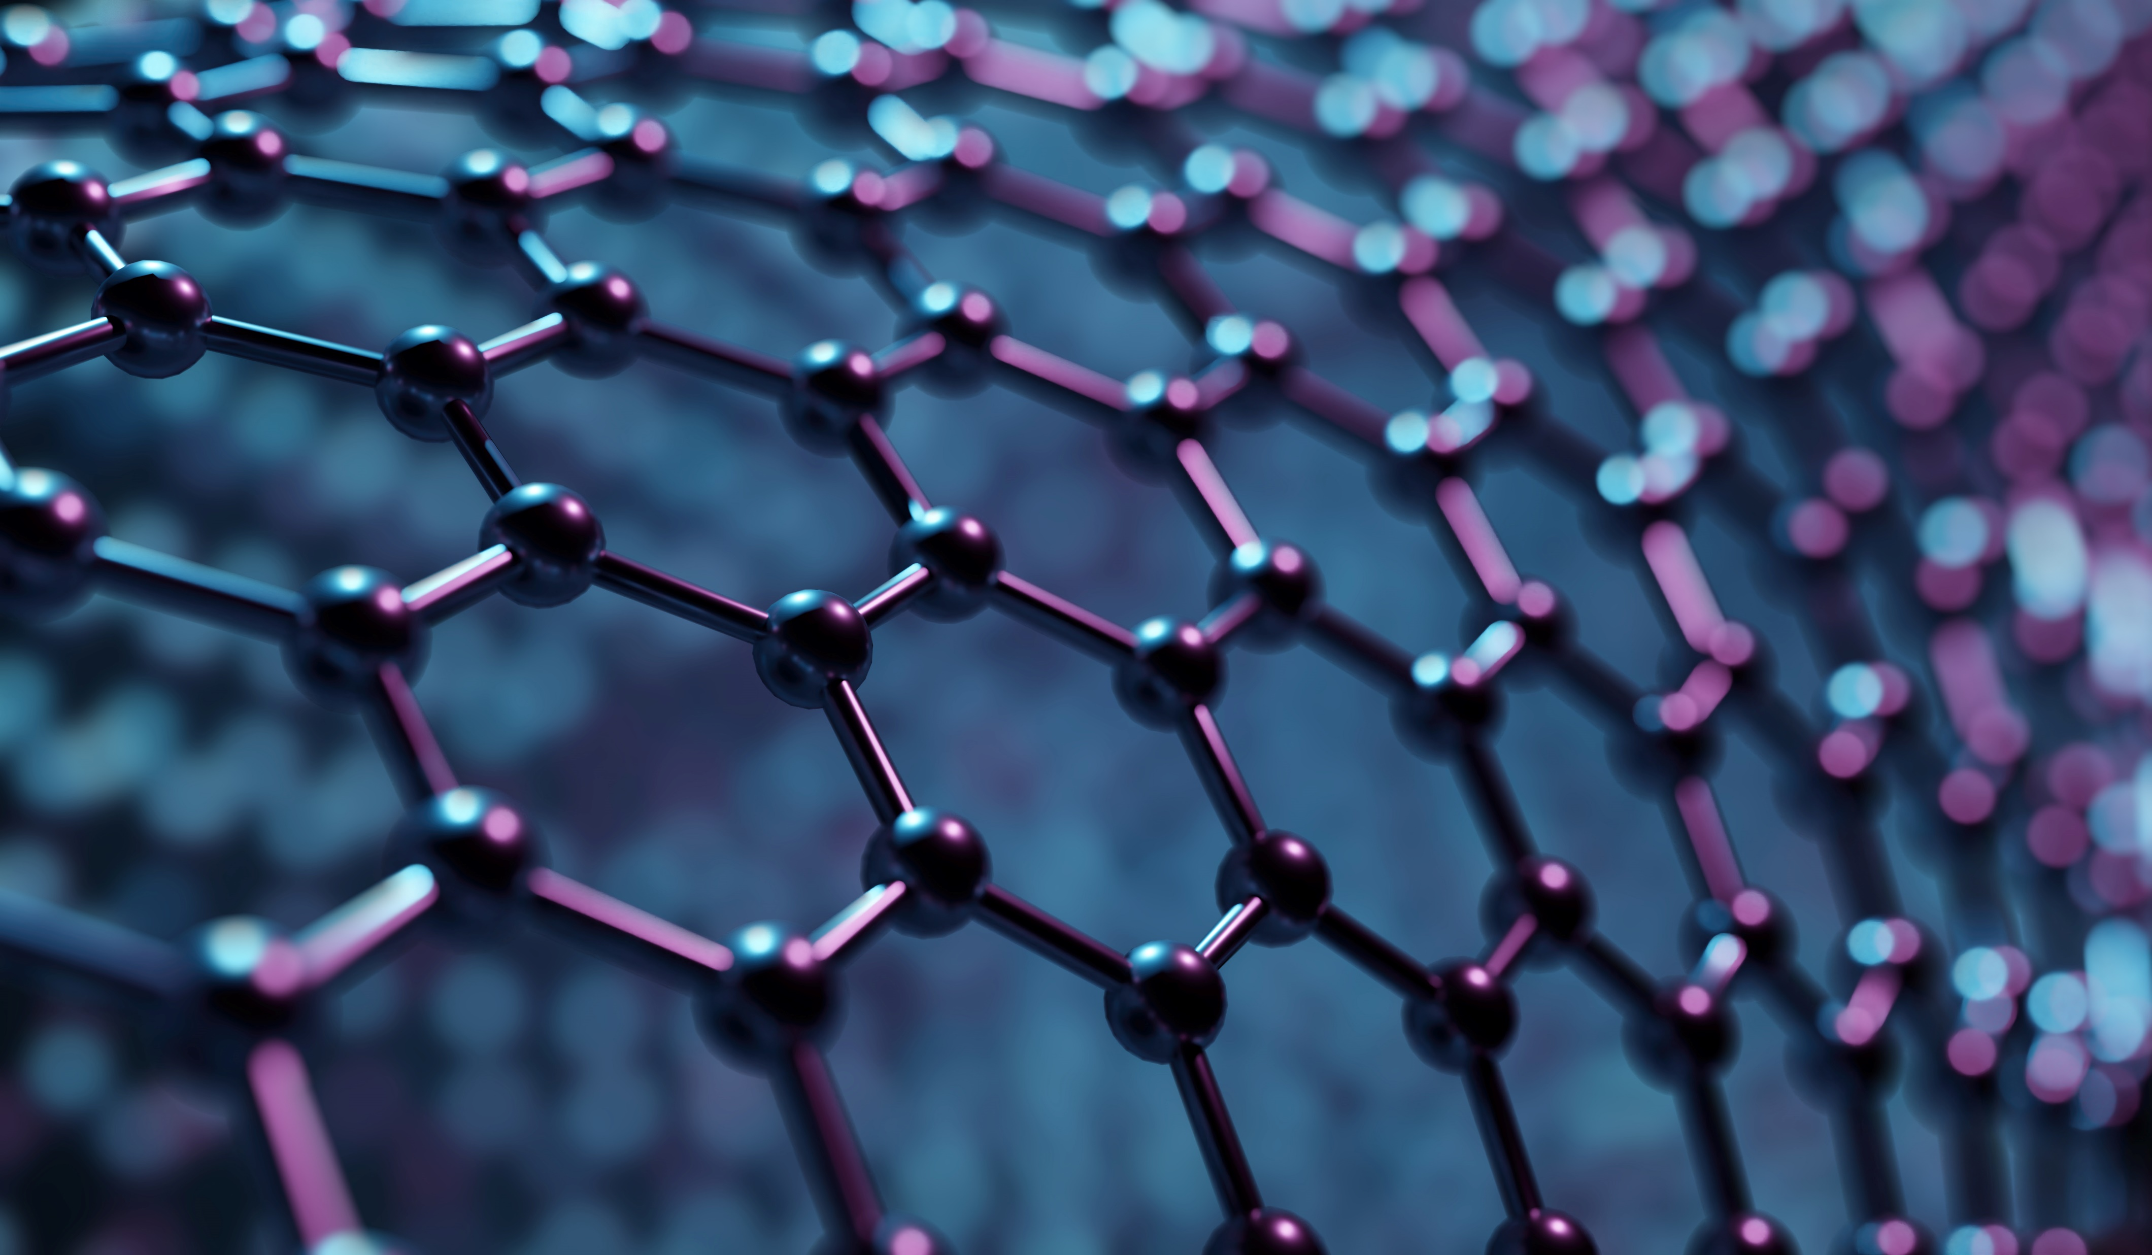


Slide 14
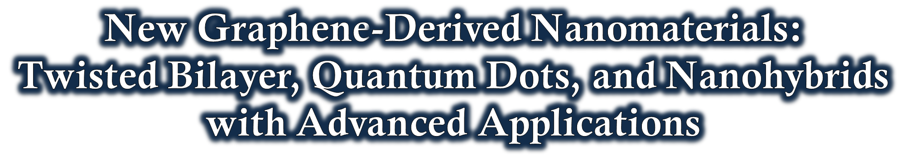
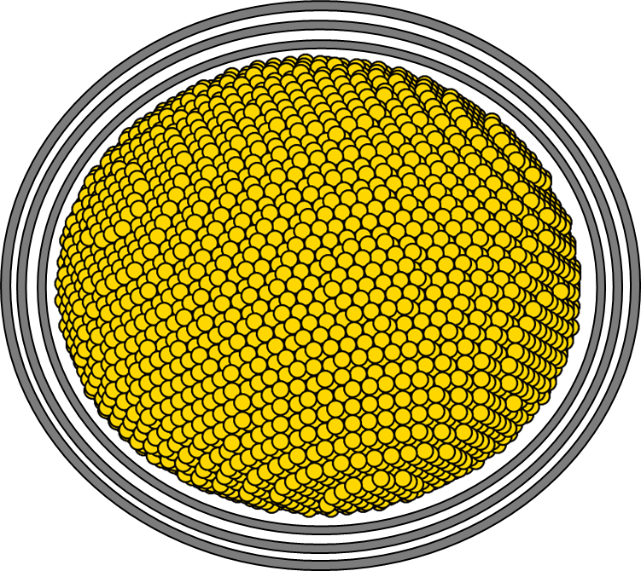
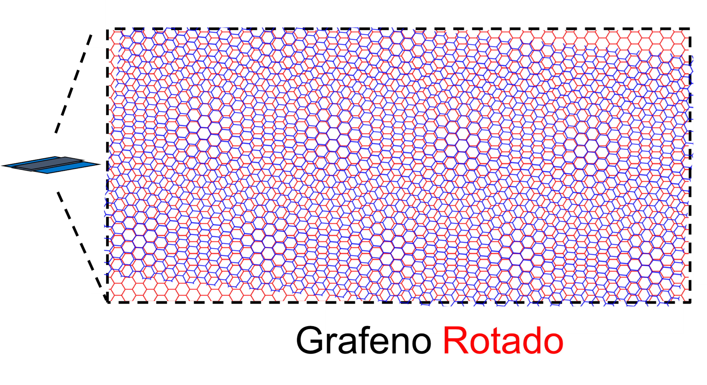
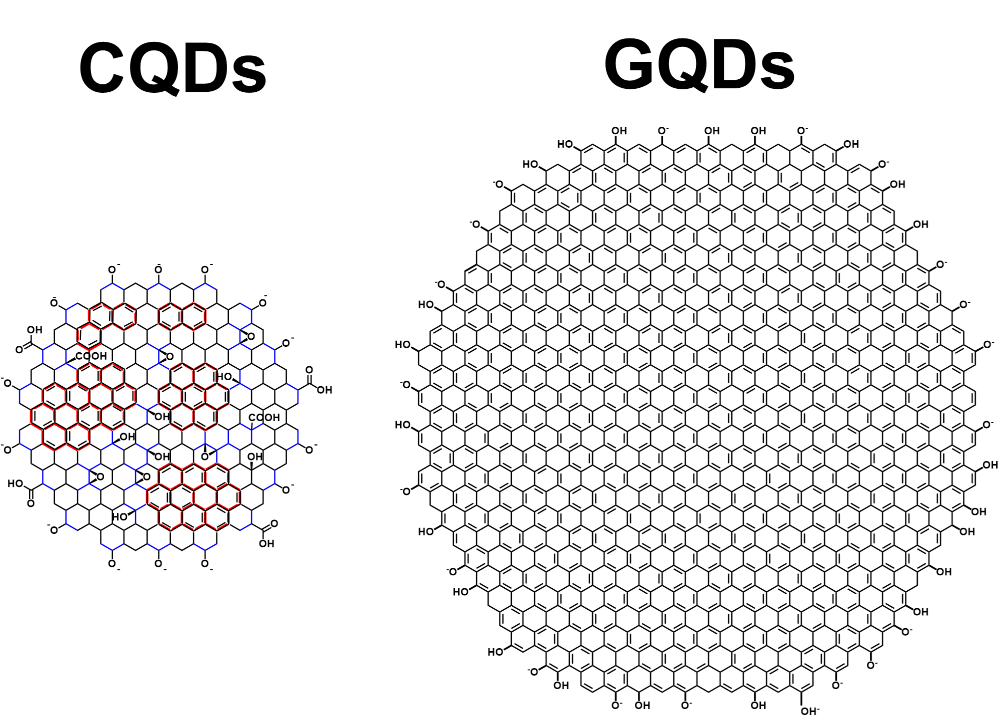
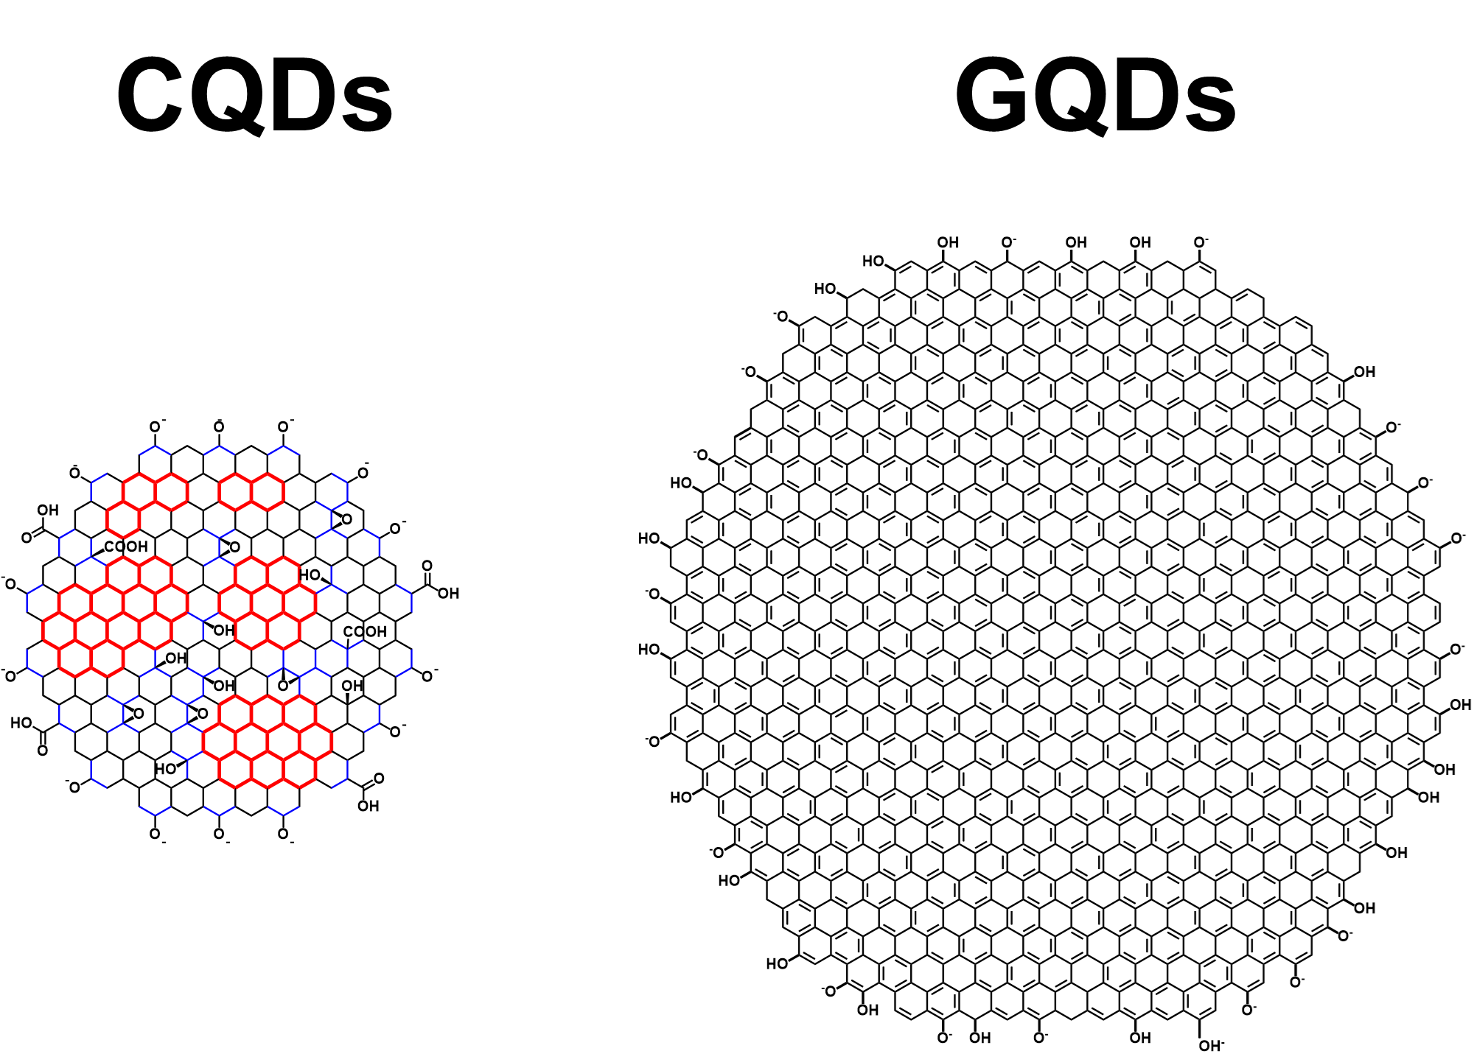
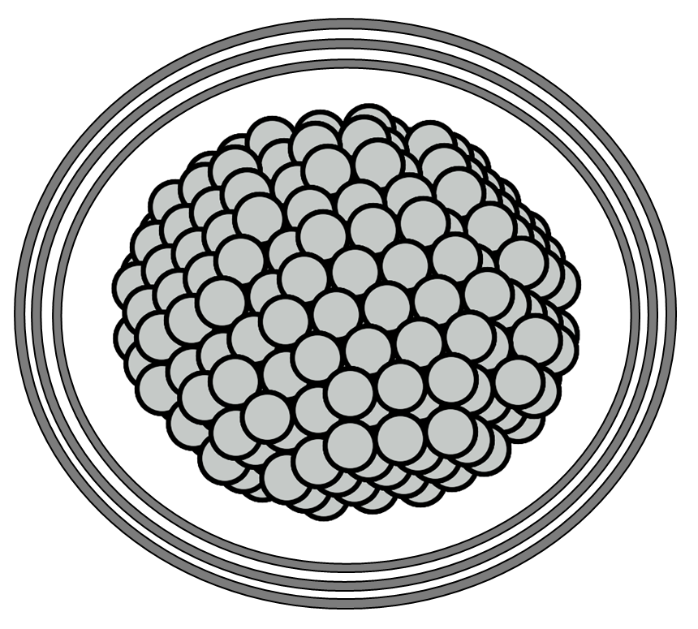
Twisted Bilayer
Graphene
Graphene
Quantum Dots
Graphene-Metal
Nanohybrids

Slide 16
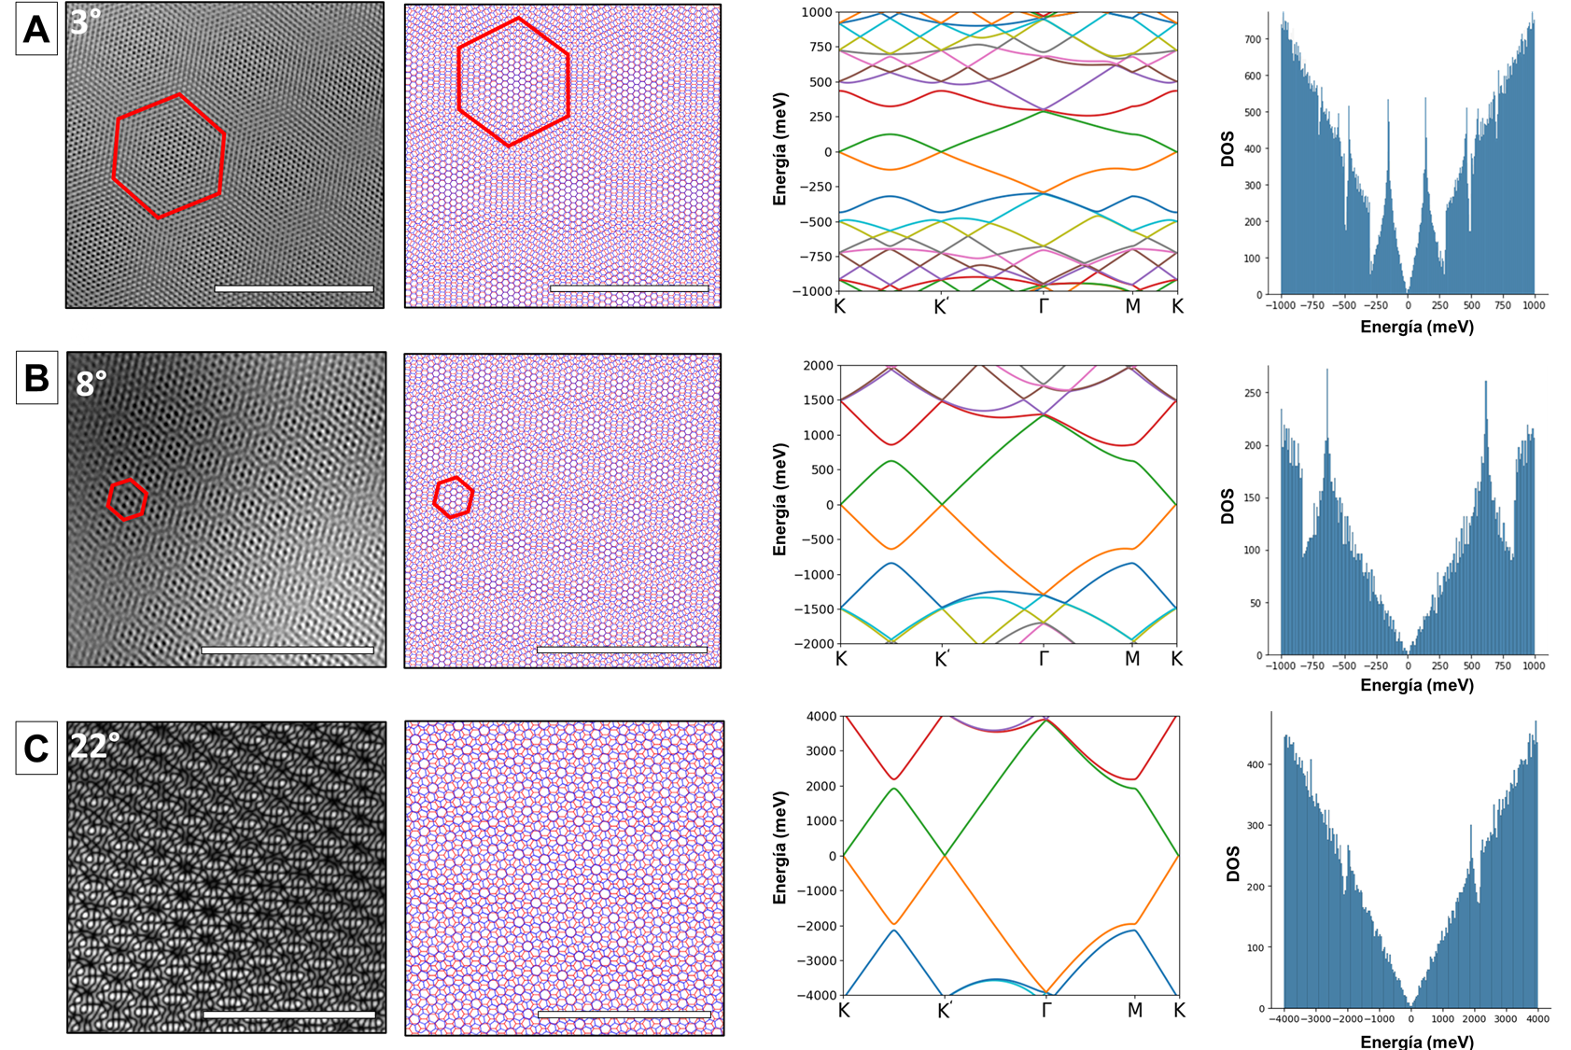
Notes:
Filtered HRTEM image (left) and simulation (right) of rotated graphene. Moiré patterns are observed for angles of 2.7° (A), 8° (B), and 22° (C). The scale bar corresponds to 5 nm.

Slide 18
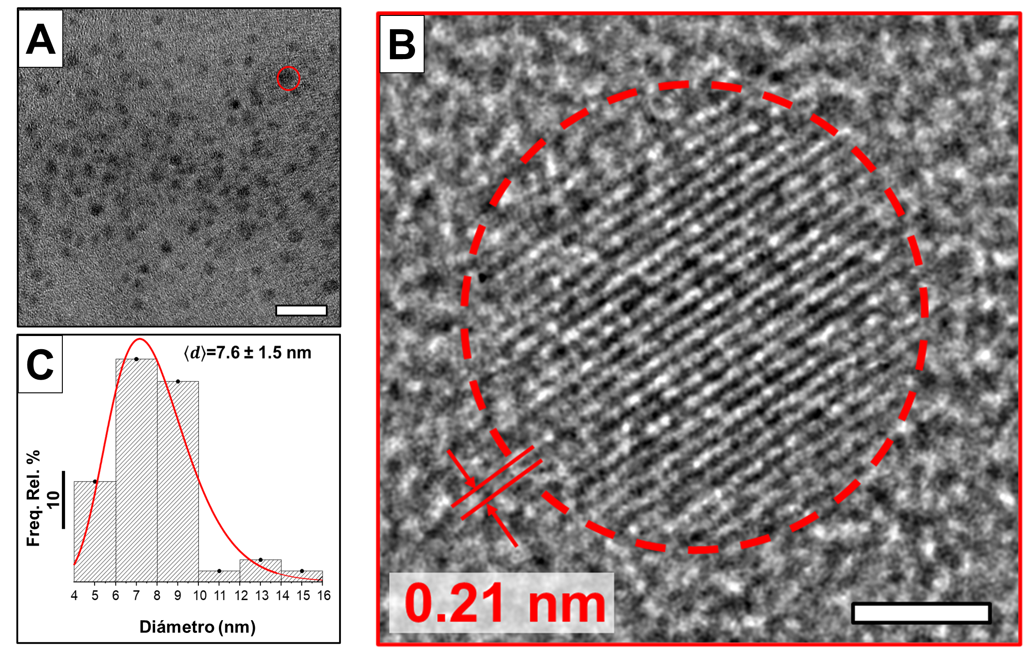
Notes:
(A) High-resolution transmission electron microscopy (HRTEM) image showing a population of graphene quantum dots (GQDs). (B) To the right, a magnified HRTEM image of an individual GQD is provided. (C) Histogram describing the size distribution for dots larger than 5 nm. Scale bars in figures A and B correspond to 10 and 2 nm, respectively.

Slide 19
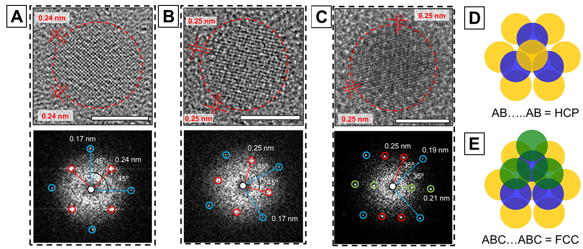
Stacking ABC...ABC
Notes:
HRTEM images (top) and FFT patterns (bottom) of few-layer GQDs (A, B, C). Top-view representation of HCP and FCC stacking, respectively (C, F). Yellow, blue, and green spheres represent atoms in layer types A, B, and C, respectively. The scale bar corresponds to 5 nm.

Slide 20
Twisted Bilayer
Graphene
Graphene
Quantum Dots
Graphene-Metal
Nanohybrids

Slide 22
